Slide 1
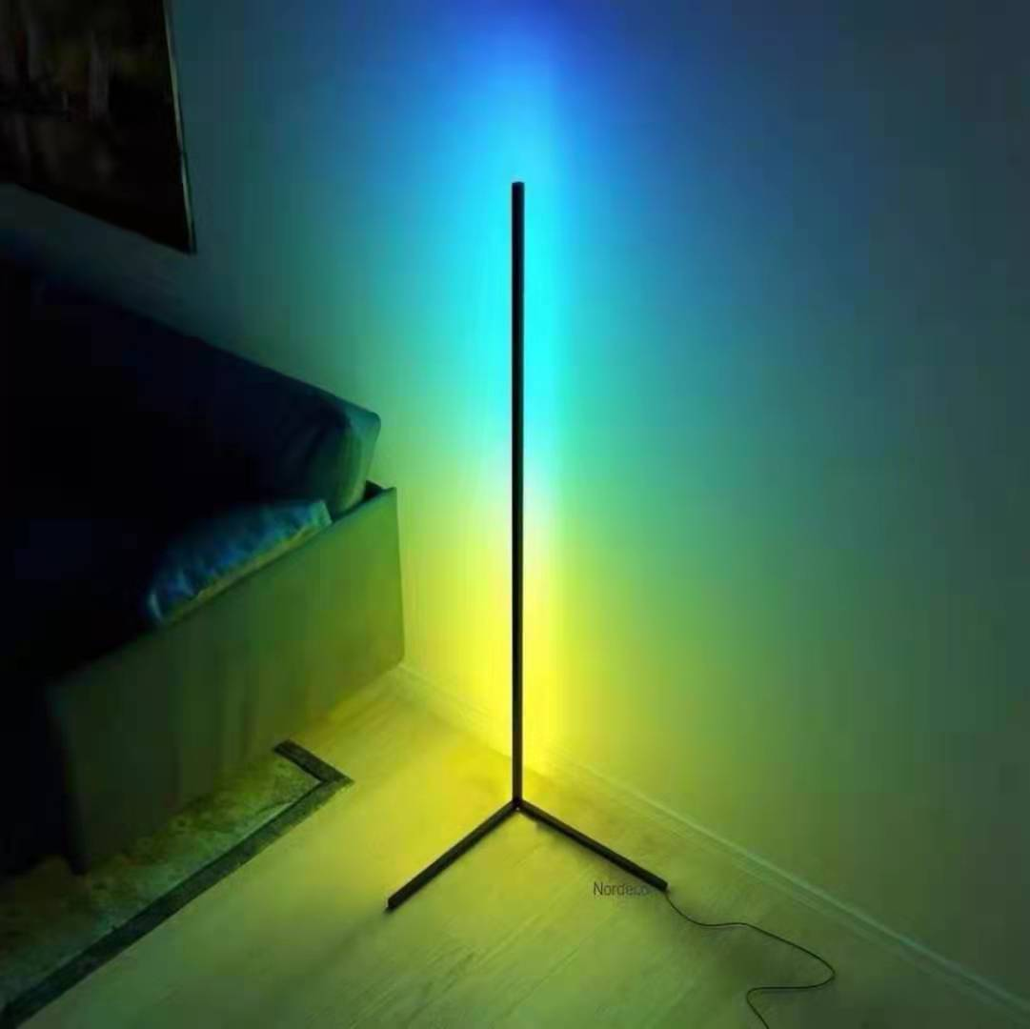
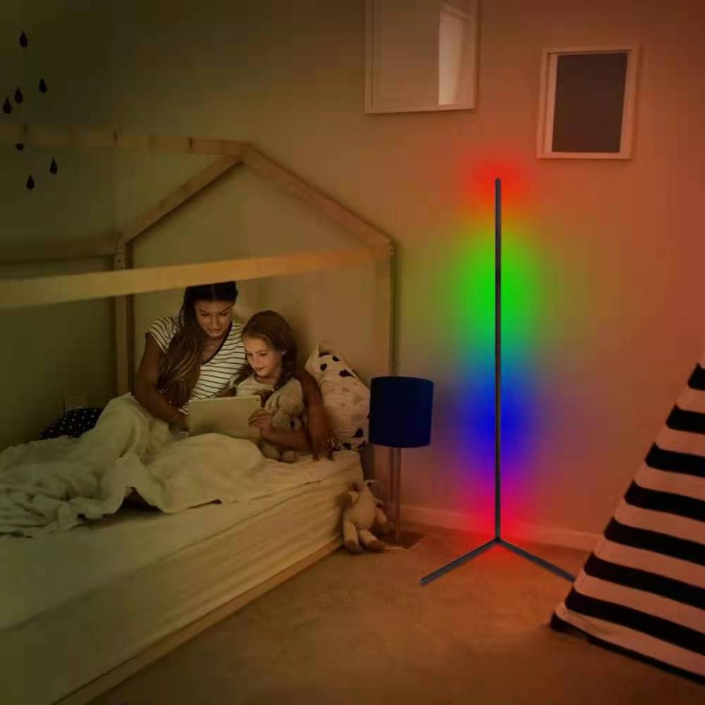
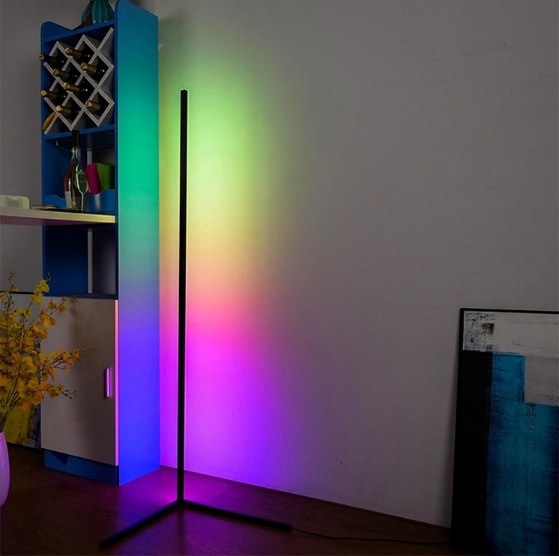
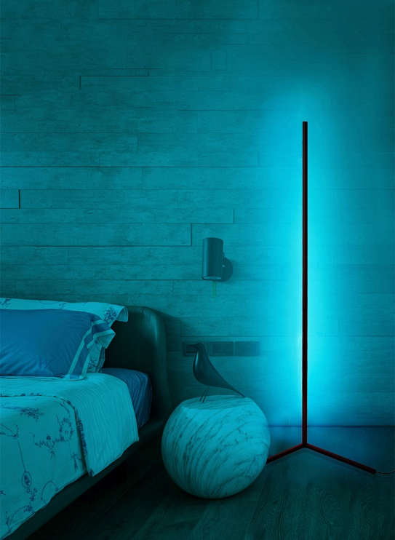
Light Every Mood
Create your own WOW factor
Bring your environment to life with this Dynamic Free Standing Elegant Stylish Corner Wall Washer
Choose whichever scene you want from your iPhone , just select what you like , waterfall , play to music of choose from 16million solid colour options fully Dimmerable . Just assemble plug in download app auto with QR code
Just assemble plug in download app auto with QR code
Great for Bedrooms | Living Rooms | Hallways | Lobby's|

Slide 2
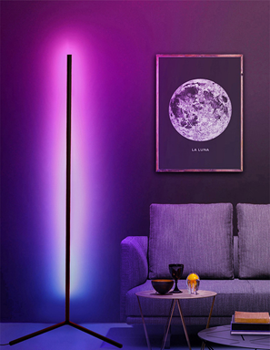
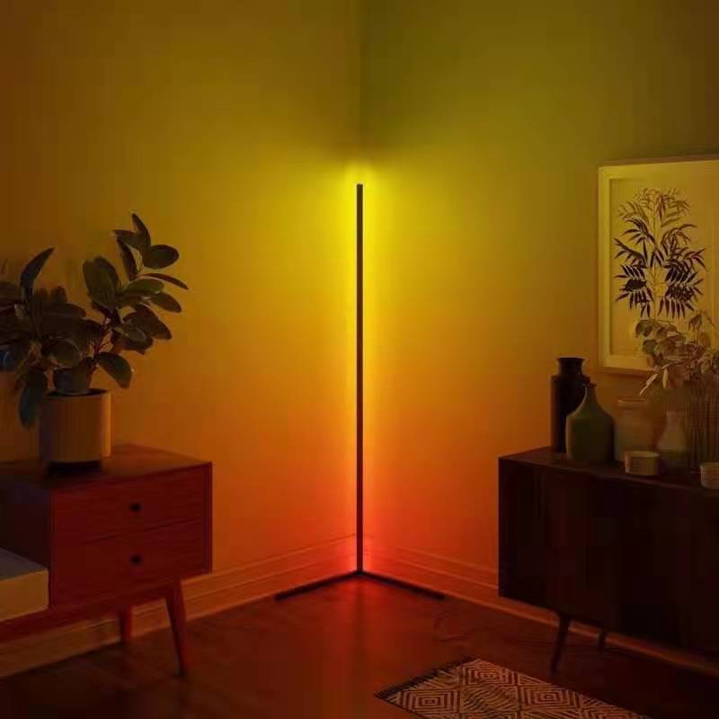
Technical Data
Specification
Input Voltage | 220-240V/50Hz | Dimming | Yes Via App
Total Power | 20w | Communication | Bluetooth Mesh
Connection | Plug into mains socket | Beam Angle | 90
Main Light Colour | 2600-6500k | Fixture colour | Black
Main Light Output | 550 Lms | Height | 1400m
CRI | >90 | IP Rating | IP20
Colours | RGBW | Warranty | 2 Years
Functionality
Free App Control | Set your own groups for max control
Select any tuneable white main light | Individually addressable
Select from 16 Colour option solid light | Dimmerable
Use 100s of themes | IES Files available on request
Preselect able timed programmes via app | Comes with Allen Key 2 meters of flex and UK plug Can work the halo in unison with LED Ribbon or RGB Profiles
Options Can work with IRIS Halo but UK bespoke UK design Can work the halo in unison with LED Ribbon or RGB Profiles | Share function for the family

